Slide 1

DataKind
Housing Insecurity

Slide 2
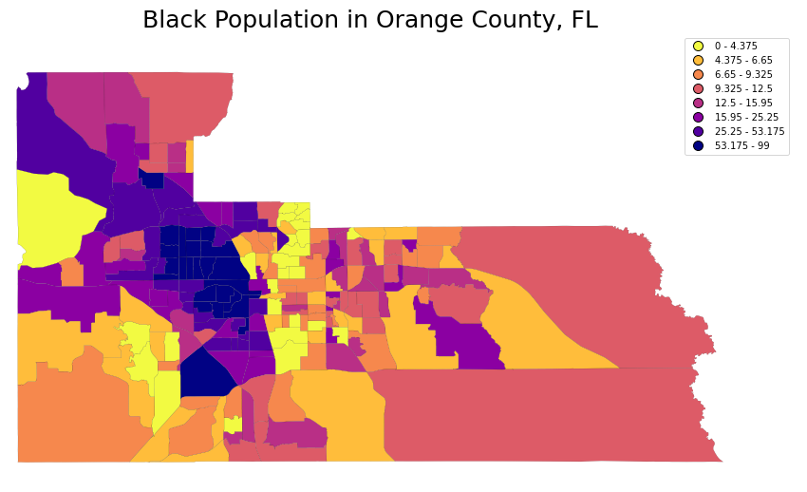
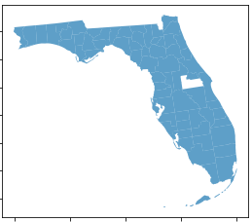
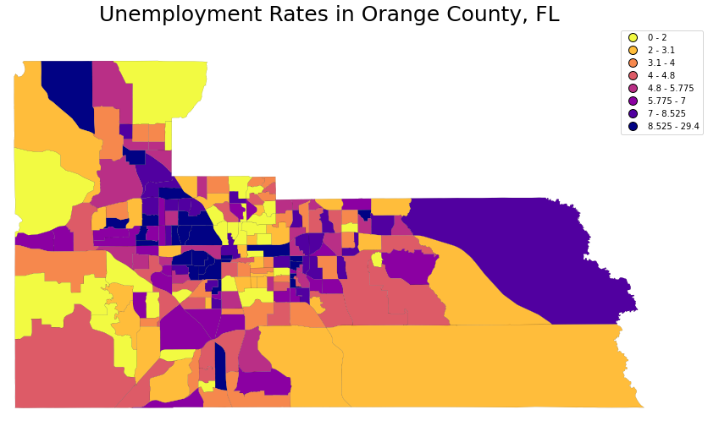
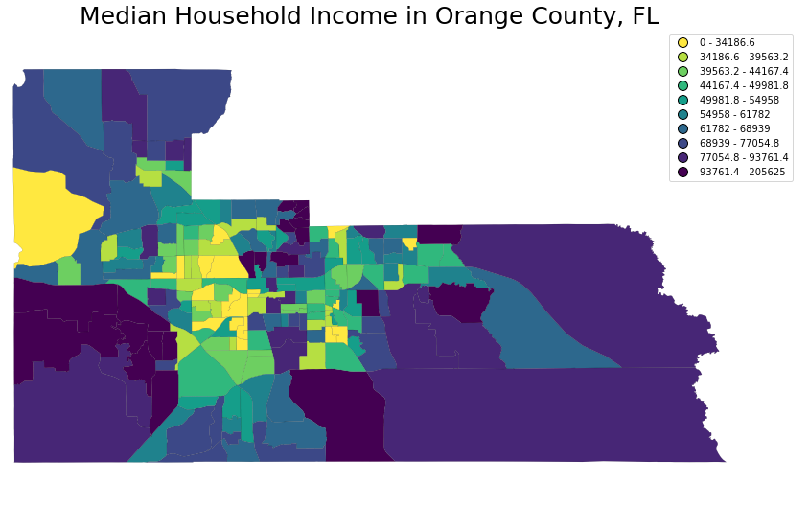
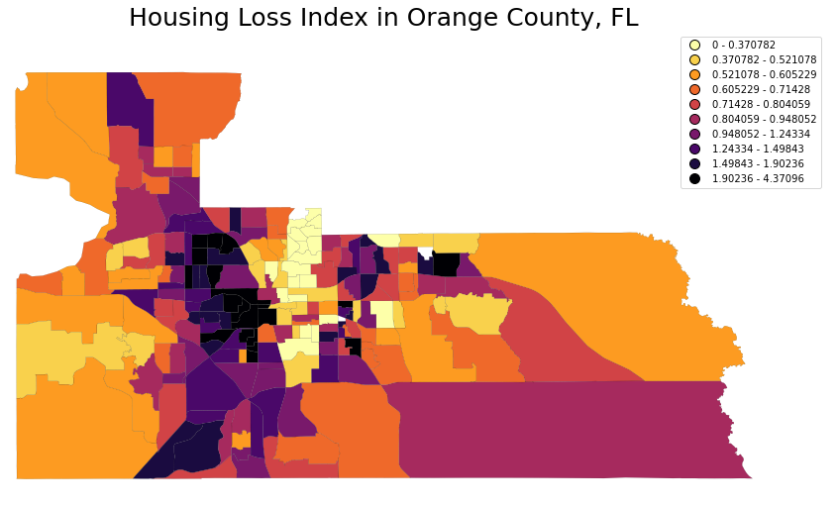
Orange County, FL
Housing loss in neighborhoods (predominately African-American) with low income and high unemployment

Slide 3
Key Findings about population in Orange County (2014-2019)
There was a 10% increase in widowed/ divorced women
Family size has shrunk 20% in five years
Baby boom 35% increase
10% increase in grandparents living with grandchildren
10% increase in disability

